Slide 1

U.S. School Data Analysis (2016–2017)

Slide 2

Exploring Federal School Code List
Presented by: Your Name
Course: Course Name
Date: Presentation Date

Slide 3
Introduction
• Analyze federal school data for insights
• Explore trends in school distribution by state
• Tools: Python, pandas, matplotlib, seaborn

Slide 4
Dataset Overview
• Dataset: 1617fedschoolcodelist.xls
• Source: U.S. Department of Education
• Columns: School Name, State Code, Zip Code, etc.

Slide 5
Data Preview
• Used df.head() to preview data
• General structure from df.info()
[Insert Screenshot of Data Preview]

Slide 6
Missing Data Handling
• Checked missing values using df.isnull().sum()
• Filled missing values using forward fill (df.fillna(method='ffill'))

Slide 7
Summary Statistics
• Generated with df.describe(include='all')
• Overview of numeric and categorical data
[Insert Summary Table Screenshot]

Slide 8
School Count by State
• Used df['StateCode'].value_counts()
• Identified top states with most schools
[Insert Printed Output]

Slide 9
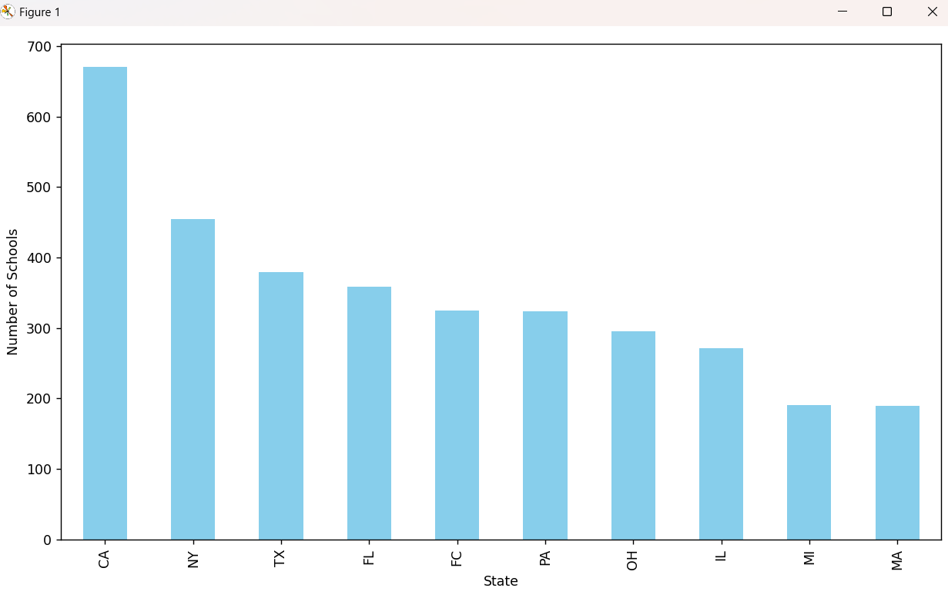
Bar Graph – Top 10 States
[📊 Bar Graph]
• X-axis: States
• Y-axis: Number of Schools
• Highlights distribution across states

Slide 10
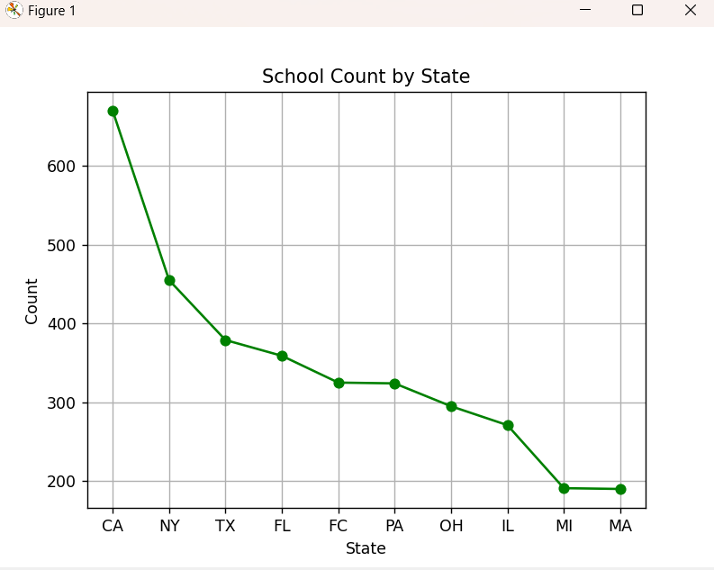
Line Graph – School Count by State
[📈 Line Graph]
• Line plot of school count by top states
• Shows comparison visually

Slide 11
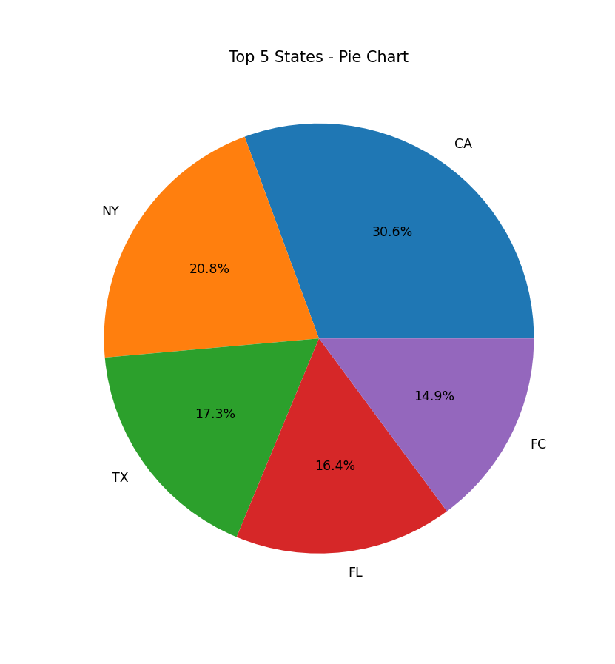
Pie Chart – Top 5 States
[🥧 Pie Chart]
• Percentage distribution of schools in top 5 states
• Good for visual share analysis

Slide 12
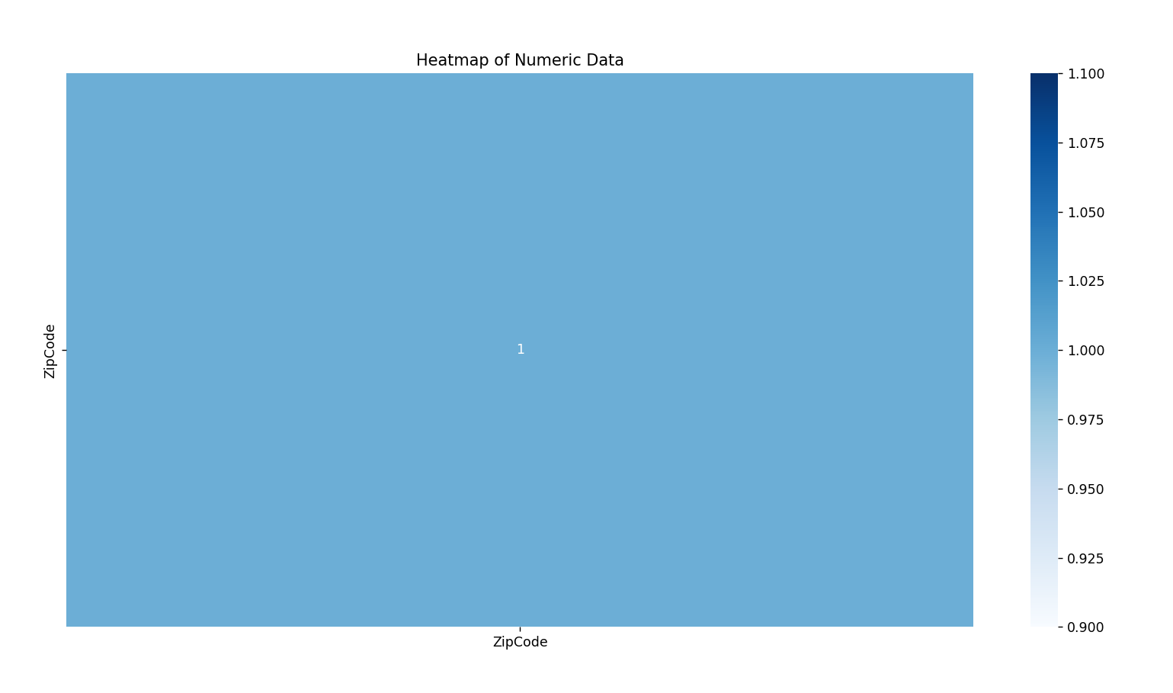
Heatmap – Numeric Data
[🌡️ Heatmap]
• Correlation matrix of numeric columns
• Visualizes strong/weak relationships

Slide 13
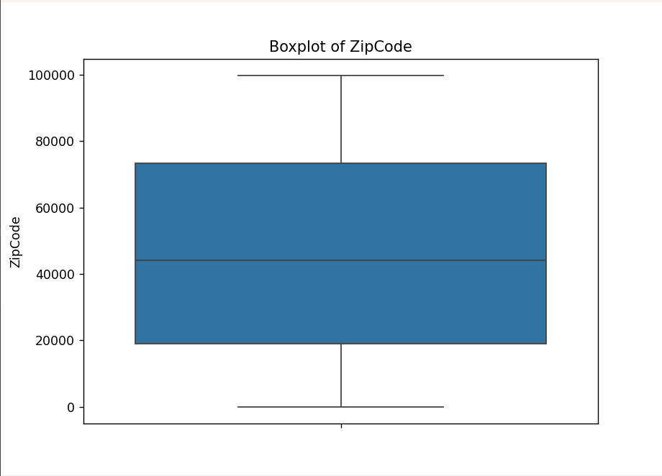
Boxplots – Numeric Columns
[📦 Boxplots]
• Outlier detection per numeric column
• Shows distribution and spread

Slide 14
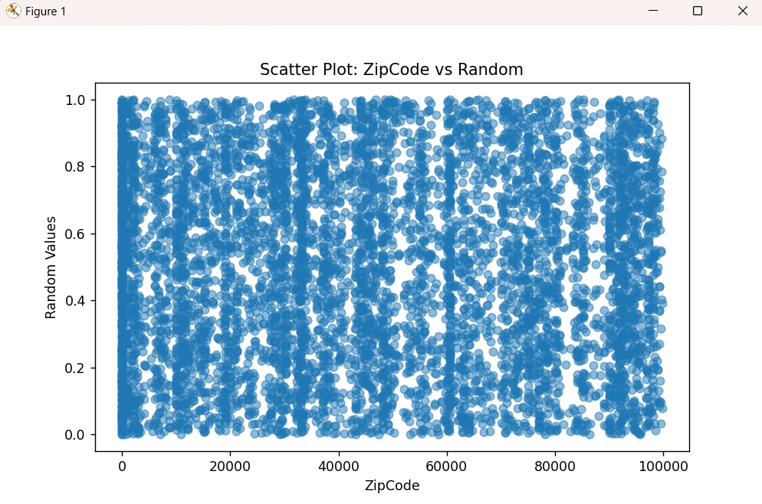
Scatter Plot – ZipCode vs Random
[📍 Scatter Plot]
• X: ZipCode | Y: Random Values
• Demonstrates regional spread

Slide 15
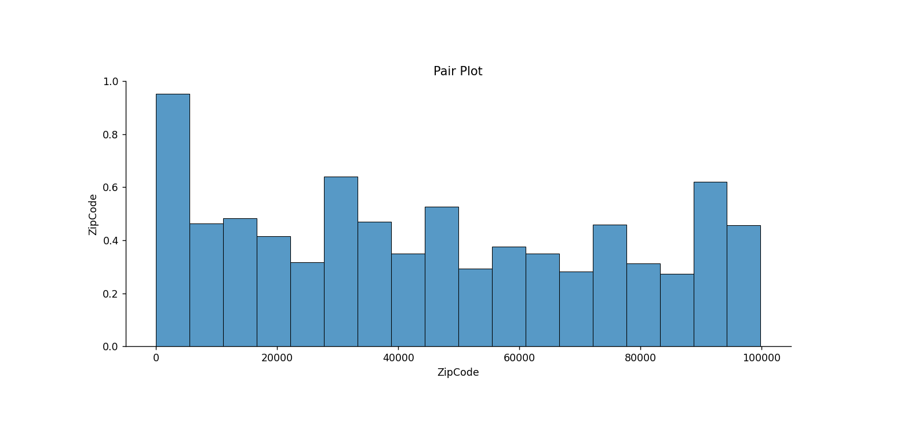
Pair Plot – Numeric Data
[📊 Pair Plot]
• Visual comparison of numeric columns
• Useful for pattern detection

Slide 16

Conclusion & Insights
• Identified top states by school count
• Cleaned data and visualized key patterns
• Future: Combine with performance data or ML models

